Slide 1

Infrastructure / DevOps
Interview Exercise
JangoMart
The information and data furnished in this document is Maven Wave Confidential Information not to be disclosed, duplicated, used
in whole or part for any purpose other than to evaluate Maven Wave’s business operation and prior experience. This restriction does not limit the recipient’s right to use information contained in the document if it is obtained from another source without restriction.

Slide 2
Agenda
Maven Wave Overview & Agile Processes (5 min)
Problem Overview & Current Challenges (5 min)
Proposed Solution / Architecture (15 min)
DevOps Demo / Code Review (20 mins)
Next Steps / Questions (15 mins)

Slide 3
Maven Wave and
Infrastructure / DevOps Practice Overview

Slide 4
Infrastructure Value Proposition
You need to build a successful foundation to deploy cloud capabilities and unlock the value of the cloud: infrastructure is that foundation.
Core Business Value
Apps
Business Enablers
Technology stack
Cloud Foundation
Infrastructure

Slide 5





DevOps Value Proposition
Legacy State
Target State
Business
Dev and Test
Build/Test
Requirements
!
!
Reducing release cycles and improving governance takes a coordinated effort with alignment on the right principles
Requirements
Build/Test
Release
!
!
Cross-Functional
Product Teams
QA
Security
Operations
Waterfall Control Point
Release
Automated Control Point
Principles
Everything as Code
Immutable Artifacts
Continuous Testing
Continuous Deployment
All facets of DevSecOps should be codified in support of enhanced automation, repeatability and review including infra, testing, policy enforcement and pipelines
“Bake in” configuration of artifacts like image composition and installation procedures to versioned artifacts to simplify audit, scalability and avoid configuration drift
Integrate automated testing into the CI process including unit, functional, performance, UI, API and regression to ensure comprehensive test coverage is performed
Target automating compliance and quality checks to accelerate releases and sharpen compliance enforcement by failing bad release candidates early and fast
Version Management
Continuous Integration
Continuous Security
Continuous Feedback
Organize and version all code in a modern, git-based, VCS. Packaged artifacts like libraries, executables, and images should be versioned in a modern, flexible binary repository
Use a mature, extensible, CI system to ensure code changes are tied to critical lifecycle activities (e.g., building, packaging, testing, review and policy enforcement) via pipelines
Shift security left by incorporating strategic security tools, policies, processes and people into the early stages of development to ensure compliance and avoid bottlenecks
Promote product-centered, cross-functional development to drive fast, iterative feedback and improvement. Use SLIs and SLOs to proactively alert potential issues

Slide 6
Problem Overview & Current Challenges

Slide 7
Problem Overview & Current Challenges
Current IT infrastructure and operational processes are unable to scale with expected demand associated with anticipated business growth and expansion to Asia market
Current physical infrastructure is at end of life and is no longer supported
Need to eliminate the large upfront costs associated with purchasing physical infrastructure (CAPEX) and move to an outsourcing model for purchasing (OPEX)
Do not currently have a flexible, automated, dynamic, codified architecture suitable for enabling business technical and operational agility
Do not currently have operational capability to support rapid and continuous delivery for new products and application enhancements
Committed to reducing carbon footprint by 50% within next 5 years, need to reduce financial and environmental impact of current physical resource consumption
Can not scale capacity with demand automatically and dynamically to optimize for performance and costs
Wasting substantial human/financial capital on undifferentiated heavy lifting
Applications may not be cloud-ready, need to review and assess
Difficult to leverage big data and machine learning to improve customer experiences

Slide 8
Proposed Solution

Slide 9
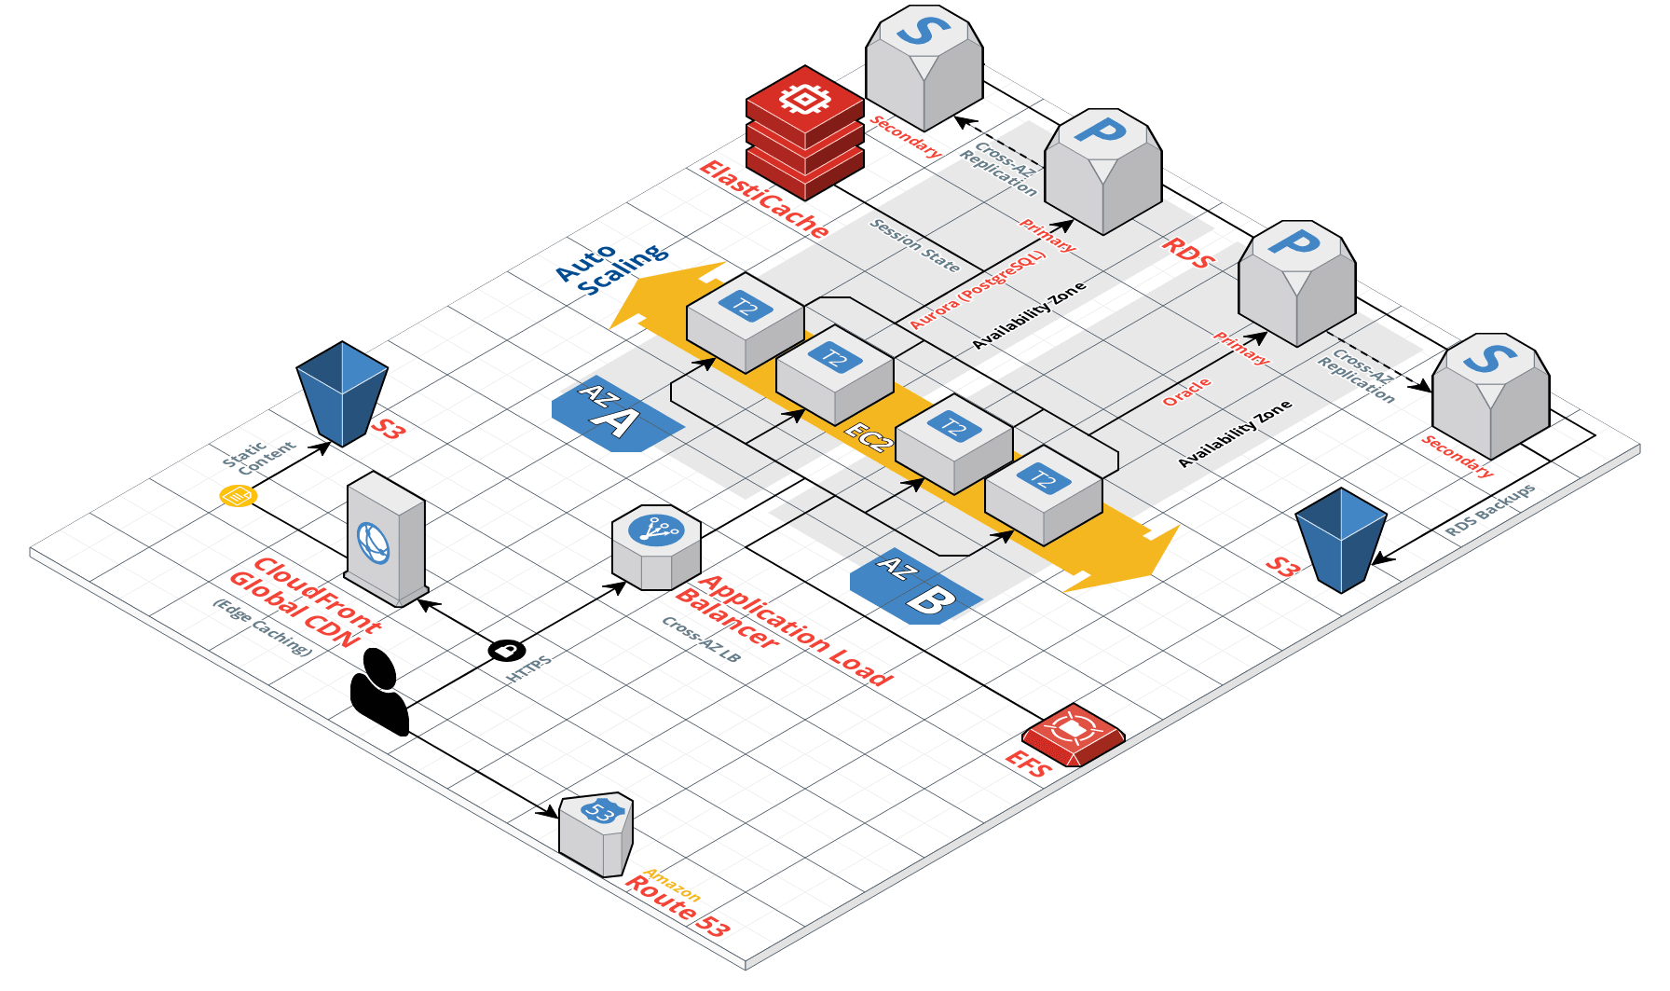
Proposed Solution
High-Level Solution Architecture For AWS Cloud Migration

Slide 10
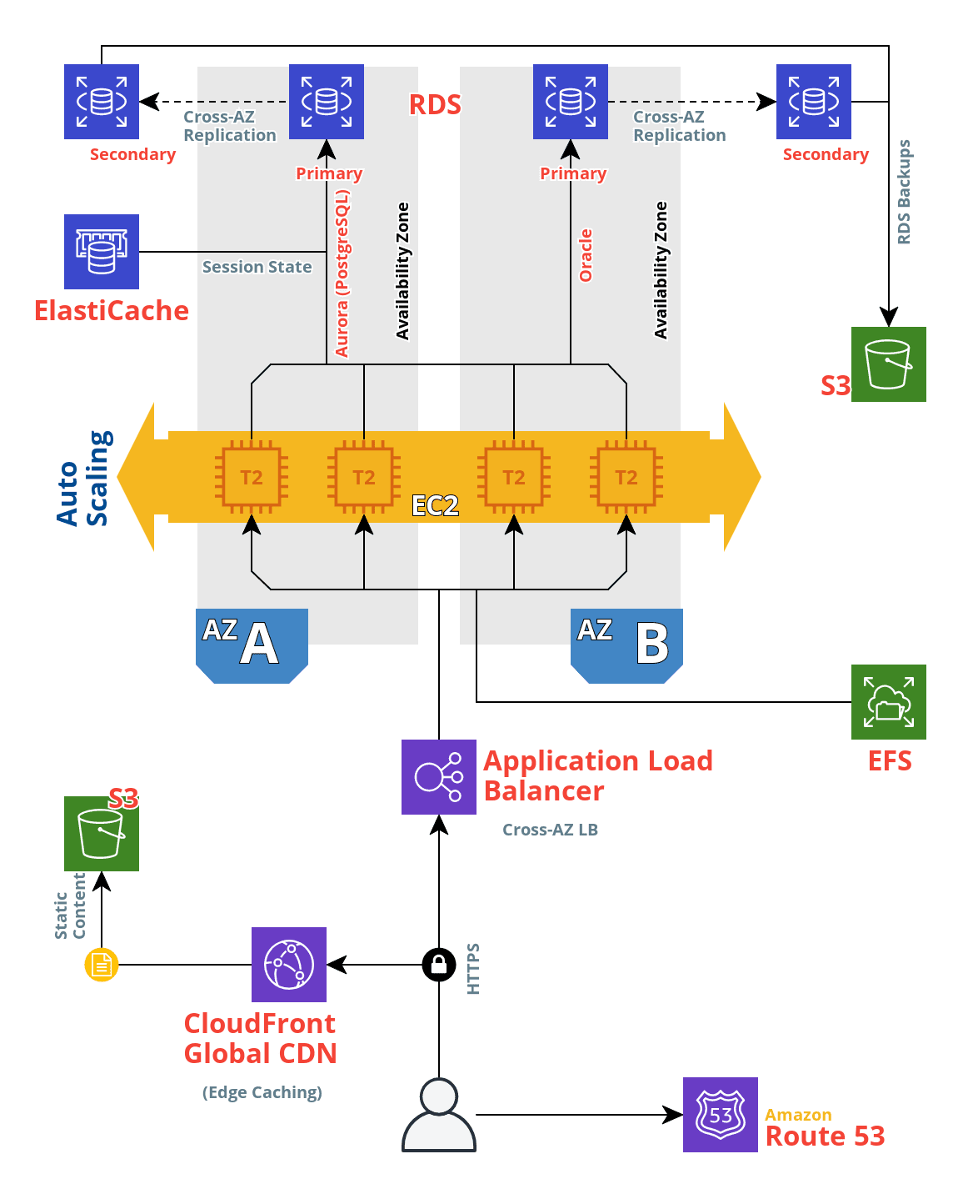
Proposed Solution
High-Level Solution Architecture For AWS Cloud Migration

Slide 11
Proposed Solution
Key Benefits Associated With Solution Concept
Shift from CAPEX purchasing model to OPEX, and enjoy a lower overall TCO
Solution concept takes full advantage of AWS-managed services to eliminate “undifferentiated heavy lifting”, enabling greater focus on driving core business value for customers and stakeholders
Highly secure, resilient, scalable, and performant architecture
Scale capacity dynamically and automatically based on demand in order to optimize for both performance and cost savings
Flexible architecture and IaaS model which enables extreme business agility
Infrastructure is managed as code, enabling rapid deployment for new products or enhancements
Architecture provides robust support for compliance and auditing needs
AWS-managed services provide high-availability inherently by design
AWS provides SLAs for guaranteed availability and support
Solution concept provides global CDN to reduce latency for users (enabling Asia expansion), architecture can be expanded to include geolocational routing

Slide 12
Proposed Solution
Architectural Details For Solution Concept
Dedicated VPC for each environment
SSL terminated at ALB, certificates are provisioned and managed by ACM
ALB uses a round-robin algorithm for load distribution
Application servers are stateless, user session data is stored in ElastiCache (enables elasticity, reduces DB load)
Traffic is load-balanced across application servers in two different AZs for resiliency
ALB is the only public endpoint available for the application
There are two public subnets (different AZs) which each contain a dedicated NAT Gateway for architectural resilience (option for Bastion host)
Application tier in ASG is deployed across two private subnets
Database tier in RDS is deployed across two private subnets
The Application tier is configured to scale in/out dynamically based on demand, to optimize for performance and costs

Slide 13
Proposed Solution
Architectural Details For Solution Concept
Content is distributed by the CloudFront Global CDN service, leveraging edge-caching for static and high-volume content
CloudFront edge-caching and content delivery technology will reduce latency for users globally (Asia market)
Network security is implemented with SGs and ACLs as appropriate
PostgreSQL uses the PG-compatible Aurora RDS DB engine, has 3x better performance and much better resiliency
Both RDS instances are configured with cross-AZ replication (warm standby node)

Slide 14
DevOps Demo and/or Code Review
DevOps Implementation Enables Rapid, Consistent, and Continuous Value Delivery
Custom CI/CD pipeline is triggered by SCM (GitHub or AWS CodeCommit)
Can define custom stages and actions (such as Source, Build, Test, and Deploy)
Pipeline orchestration is handled by cloud-native AWS CodePipeline service
Build and testing actions are handled by cloud-native AWS CodeBuild service
Deployment automation is handled with cloud-native AWS CodeDeploy service
DevOps implementation is highly customizable and will be tailored to suit business and technical requirements for development and release processes
Pipeline lifecycle hooks and notifications are available for tight integration with external services as needed
Can add manual review stages if and where necessary within the pipeline
Predefined and custom deployment configurations are available to support requirements for application availability and testing (in-place, blue-green)
Automatic rollback capability is available
Pipeline is built entirely upon AWS-managed services, no need to manage low-level tooling capacity, availability, resiliency, or security

Slide 15
DevOps Demo and/or Code Review
DevOps Implementation Enables Rapid, Consistent, and Continuous Value Delivery
Let’s take a look…
Pipeline overview in AWS console
Deployment demonstration with code change and git push

Slide 16
Thank You
Next Steps/Questions?

